Slide 1
Online Enrollment Pages Reginald Tremor The University of Arizona Global Campus CST 499: Capstone for Computer Software Technology Charmelia Butler September 4, 2025

Slide 2
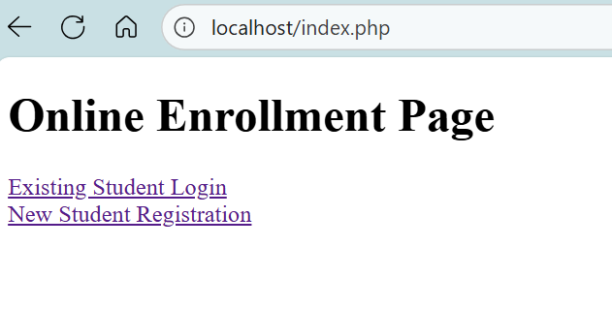
Landing Page (index.php)
Landing page allows student to login into an existing account, or register as new student
Notes:
The HTML landing page functions as the client-side entry point of the course enrollment system. The landing page uses anchor tags sending the user to login.php and register.php to start the authentication and registration workflows, respectively. The page has a clean layout and an easy usability pattern with access to all the backend functionality.

Slide 3
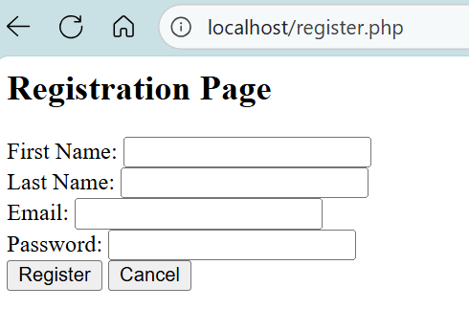
Register Page (register.php)
A new student is required to fill out key account information to register
Notes:
The register.php script will manage the new user registration process of form data gathering, password hashing, and inserting the user in the Users table using a prepared SQL statement. The script starts a session, stores the new userID, and then, if successful, directs to profile.php. Core functions include sessionstart(), passwordhash(), and mysqli::prepare().

Slide 4
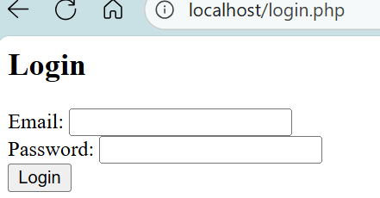
Login Page (login.php)
A returning student must login to manage their courses
Notes:
This page manages user authentication using mysqli::prepare() and passwordverify() credential checking against the database. If successful the script will then start a session with $SESSION['userID'] and redirect to profile.php. Its core functionality is to provide secure login, manage sessions, and conditionally handle errors. Core functionality is then to provide secure login, manage sessions, and conditionally handle errors.

Slide 5
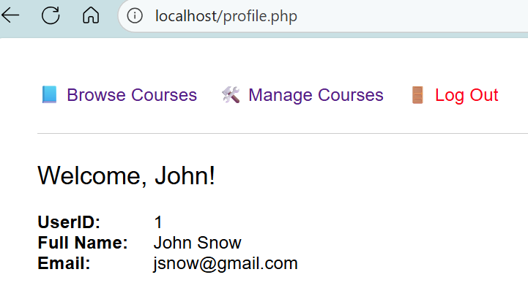
Profile Page (profile.php)
On the profile page, the student can manage enrolled courses, browse courses, and logout
Notes:
This page displays user profile data after confirming session access with $SESSION['userID']. It uses mysqli::prepare() to securely retrieve user details and htmlspecialchars() to prevent XSS. The navigation links for page provided course browsing, management, and logout options.

Slide 6
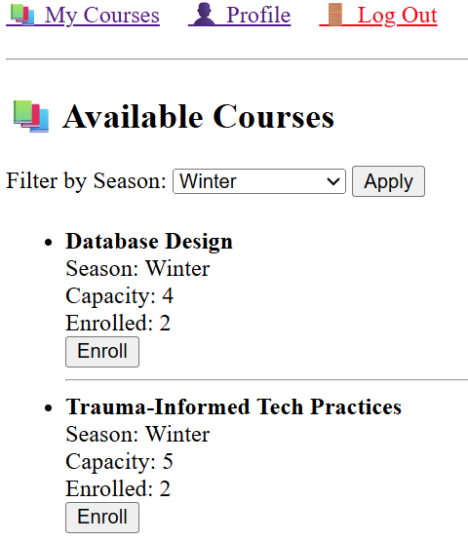
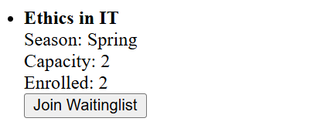
Browse Courses Page (courses.php)
Allows one to browse courses and filter by season
Each course will display its capacity and number of students enrolled
Ability for students to register or to be waitlisted
Notes:
This page displays available courses. The user can filter seasons (optional) using $GET and dynamic SQL.
This page checks for current enrollments via mysqli::prepare() and whether that capacity is still full, using a conditional to render either the enroll or waitlist button.

Slide 7
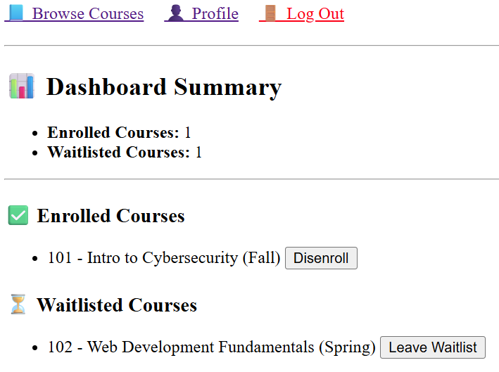
Manage Courses Page (mycourses.php)
Outlines a summary of how many courses/waitlisted that student has been enrolled
Ability for student to disenroll or leave waitlist
Notes:
The dashboard shows a user’s courses that they are enrolled in, and the courses they are placed on a waitlist for using JOIN queries and the COUNT() function for summary totals, all managed by using $SESSION['userID'], and each output is secured using htmlspecialchars().
Each course entry has logic that conditionally displays a "Disenroll" or "Leave Waitlist" button that will execute a DELETE statement to remove the use's record from the specified table. As a complete set of functions, the dashboard allows for real-time use of courses and user-enrollments.

